Slide 1
NWEN304 Final Group Presentation
Group members:
* Zach Williams * Devon Gregory
*Christopher (Chris) Visser-Fee * Wenyu Wang

Slide 2

Art Gallery

Slide 3

Heroku Hosted
https://artgallery-team7.herokuapp.com/

Slide 4











Slide 5
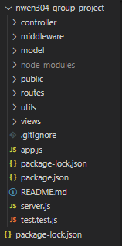
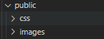
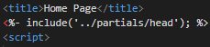

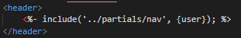
Structure
Using an MVC structure

Slide 6
Contribution and Distribution
Apis (Devon)
Controllers (Devon And Chris)
Database (Chris And Devon)
Frontend (Zach And Devon)
OAuth (Wenyu And Devon)
Heroku (Wenyu And Devon)
Testing (Zach And Devon)
Security, Verification, (Devon, Zach And Chris) login/logout and Sessions
If it needed doing, someone did it.
Original distribution was an estimate ended up just everyone talking/typing and sharing resources to get the job done.

Slide 7

Privacy Considerations
Information is hashed and privacy considerations were taken into account ;)

Slide 8
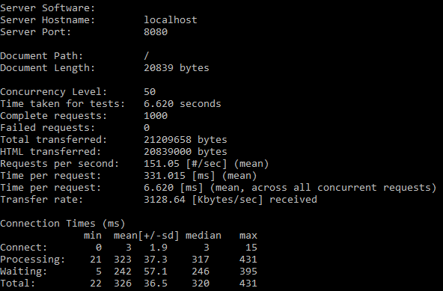
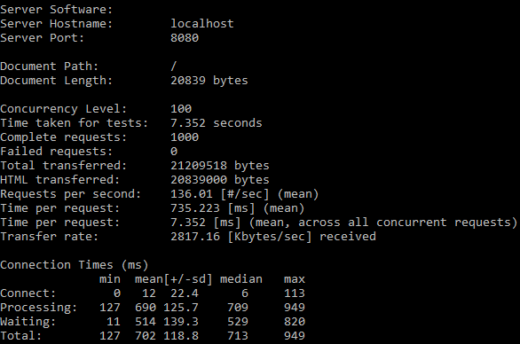
Performance Apache Benchmark:
Targeting http://localhost:8080/ with 1000 users with a concurrency of 50:
Targeting http://localhost:8080/ with 1000 users with a concurrency of 100:
Notes:
As can be seen with both results the same number of requests were served by each and double the concurrency was used from the left to the right.
All requests that were sent were served with no failed requests. Looking at the “mean” connection time despite the 2x increase in concurrent user there was a 4x increase in the initial connection time. This is the only time where a 4x increase occurs and across the board for the other means of processing, waiting and total there was a roughly 2x increase along with our 2x increase in the number of concurrent requests.

Slide 9
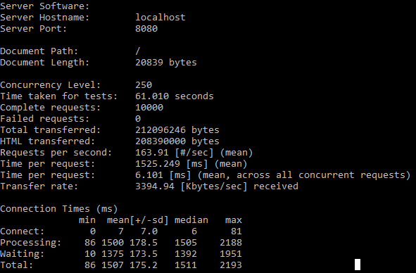
Performance Apache Benchmark:
Targeting http://localhost:8080/ with 10000 users with a concurrency of 250:
Notes:
Increasing the number of requests sent 10x as well as the concurrency level increased 5x from the initial request of 50-to-250 had an overall effect of increasing the time taken for all the request to 10x which is expected.
The overall connecting time was quite a surprising result from the mean time of 7 which is roughly half of the 100 concurrency previously, with all the other results matching the scale increase in the number of requests with all their concurrent rate.

Slide 10
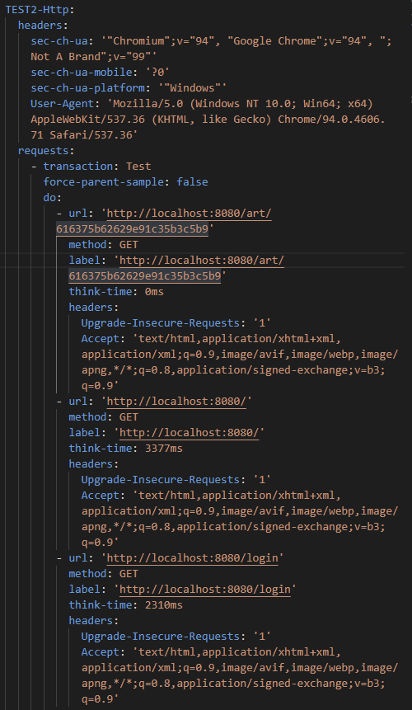
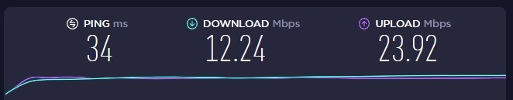
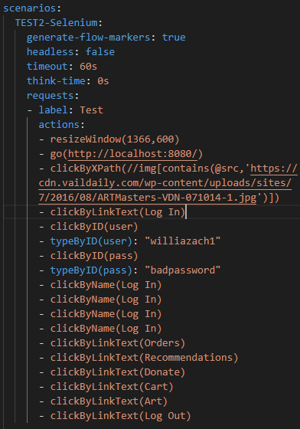
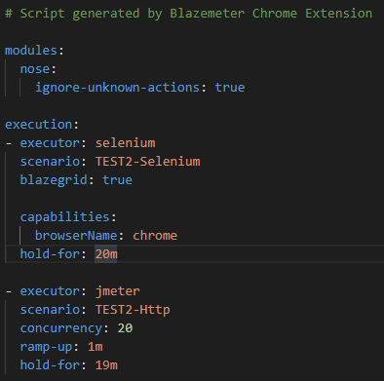
Jmeter/BlazeMeter Chrome Extension Performance
Notes:
Did some further load testing using Jmeter/Blazemeter chrome extension to test performance.
I was going to use Jmeter Cli however in the docs they recommended not using the Cli version for load testing (they didn’t really give an justification for this),
they provided this extension has a recommendation to show performance/metrics.
For running this test I was using VS code to run the web application on my localhost and was running the extension on the same computer.
I didn’t have the fastest computer nor internet so as with discussion with devon we said that some of the metrics/ms response time
Might be slightly skewed as running the individual responses for the art gallery were on a very poorly performing system however does show what it is like
In the lease ideal situation
Record Selenium and HTTP traffic to create a load and functional tests (Apache JMeter Compatible).

Slide 11
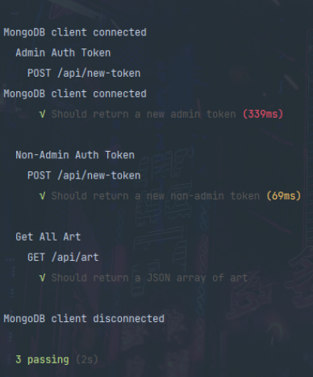
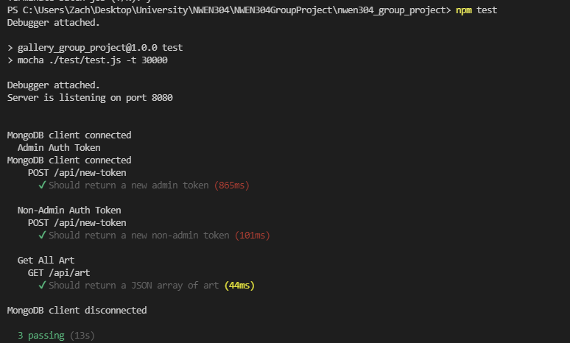
Mocha/Chai Tests
Devon running the test
Zach running the test
Notes:
I had a lot of problems running the tests so I had to put a lot of delay on the requests themselves because of my internet but when there was a 30second delay it was enough time for my internet to catch up.
Devons results are more reflective of what would normally happen.

Slide 12
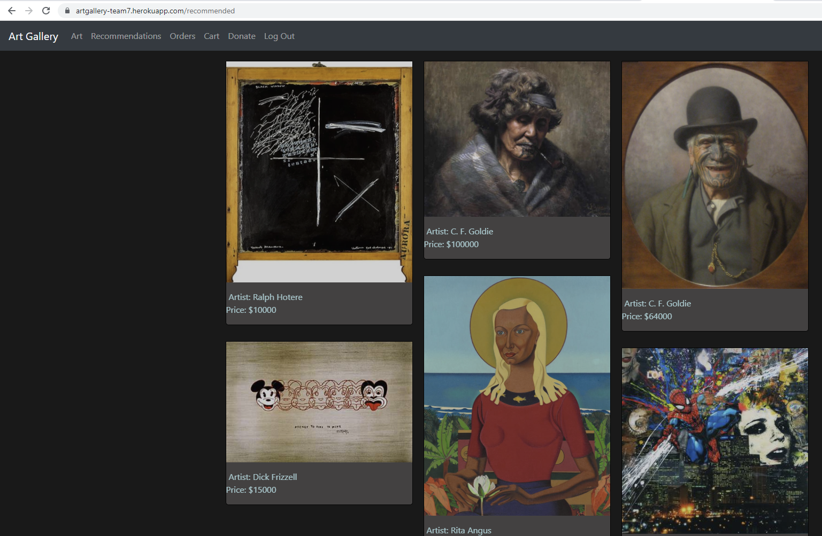
Recommended
Recommends art based on your geolocation
France = French artist will be recommend
Notes:
Sparkle and wikipedia
Geolaotion --- recommend the art work by an artist

